Slide 1
Machine Learning Yearning
End-to-end
deep learning
饶正锋
Nov 2018

Slide 2
outline
What is End-to-end?
Examples of End-to-end
End-to-end: Pros and cons
Pipeline or End-to-end ?
More

Slide 3
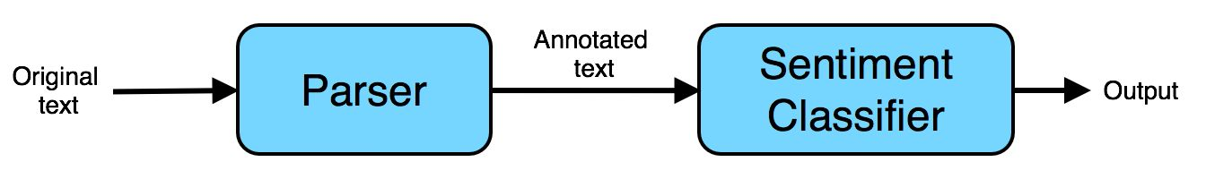
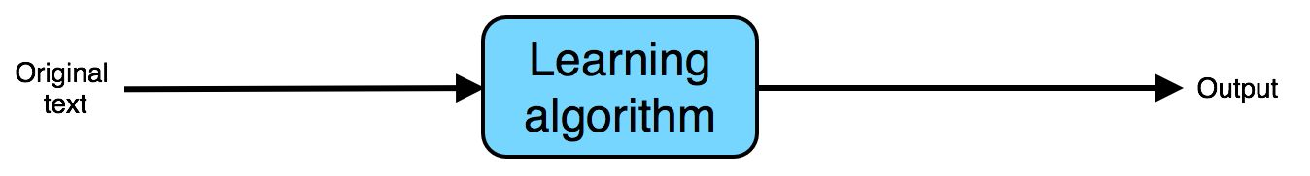
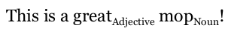
What is End-to-end deep learning?
[Task] sentiment classification:
This is a great mop! --positive
This mop is low quality--I regret buying it. --negative
Pipeline(traditional ML):
End to end(Deep Learning):
Two components:
1. parser: annotate texts, identify import words
2. sentiment classifier: class the annotated texts, giving adjectives a higher weight
Input the raw, original text:
This is a great mop!
Try to directly recognize the sentiment
End-to-end:
Asking the learning algorithm to go directly from the input to the desired output.
Notes:
学习曲线是提高学习算法性能的简单但功能强大的判定工具。
学习曲线是一条关于样本数量和损失函数之间的曲线，对机器学习(深度学习)过程进行判断，进一步调整学习参数，提高模型的泛化能力。
1

Slide 4
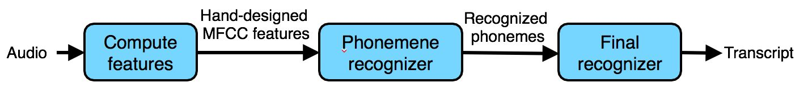
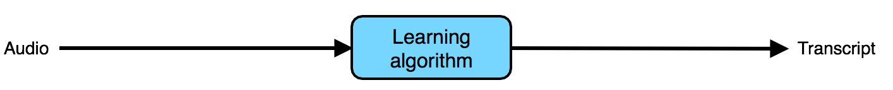
Examples of End-to-end
[Task]speech recognition
Pipeline:
End to end:
Three components:
1. Compute features: Extract hand-designed features, such as MFCC
2. Phoneme recognizer:recognize the phonemes in the audio clip.
3.Final recognizer: Take the sequence of recognized phonemes, and try to string them
together into an output transcript.
Notes:
假设当前训练集只有2个样本，学习算法就可以很清楚的记住这两个模型的特征，有意义的没意义的都给记住了，然后准确率就达到了100%，相应的错误率就是0%；这对于验证集就不是什么好事，比如说刚刚的样本一个是黑猫，另一只是白狗，我们的算法是判断是猫还是狗，经过这两个样本的训练，模型很可能把颜色记住了，对于验证集里面的黑狗很有可能被识别成猫，白猫被识别成狗，这样准确率就会很低，错误率就很高。
1

Slide 5
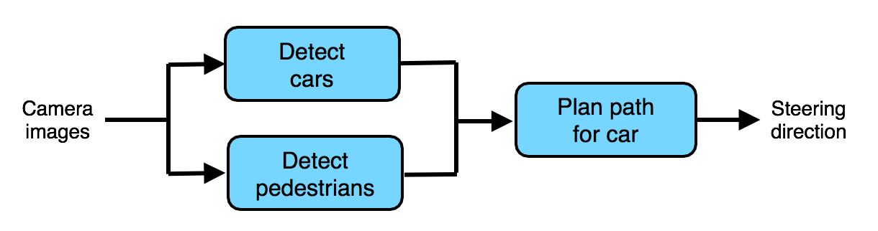
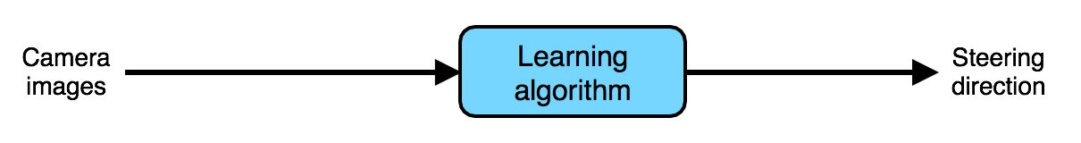
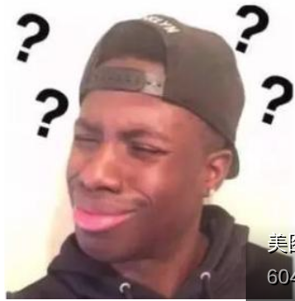
Examples of End-to-end
[Task]autonomous car
Pipeline:
End to end:
Three components:
1. Detect cars
2. Detect pedestrians
3. Plan path for car
Andrew Ng:
Even though end-to-end learning has seen many successes...but I’m skeptical about end-to-end learning for autonomous driving...
Notes:
假设当前训练集只有2个样本，学习算法就可以很清楚的记住这两个模型的特征，有意义的没意义的都给记住了，然后准确率就达到了100%，相应的错误率就是0%；这对于验证集就不是什么好事，比如说刚刚的样本一个是黑猫，另一只是白狗，我们的算法是判断是猫还是狗，经过这两个样本的训练，模型很可能把颜色记住了，对于验证集里面的黑狗很有可能被识别成猫，白猫被识别成狗，这样准确率就会很低，错误率就很高。
1

Slide 6

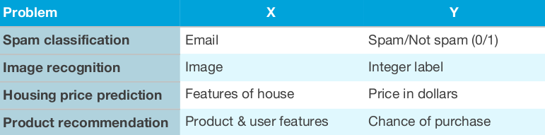
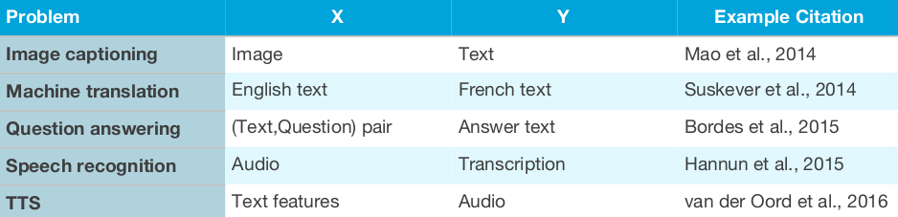
End-to-end: Pros and cons
Pros:
Cons:
1. No hand-engineered needed
2. Won’t be hampered by the limitations of hand-engineered features,some useful information might be dropped by hand-engineered features
3. Directly learning rich outputs
1. Needs lots of labeled data for “both
ends”—the input end and the output end
Labeled Data!!!
Traditional supervised learning:
h: ​ X→​Y (y:integer / real number)
End-to-end DL:
when the training set is small, it might do worse than the hand-engineered pipeline
Notes:
假设当前训练集只有2个样本，学习算法就可以很清楚的记住这两个模型的特征，有意义的没意义的都给记住了，然后准确率就达到了100%，相应的错误率就是0%；这对于验证集就不是什么好事，比如说刚刚的样本一个是黑猫，另一只是白狗，我们的算法是判断是猫还是狗，经过这两个样本的训练，模型很可能把颜色记住了，对于验证集里面的黑狗很有可能被识别成猫，白猫被识别成狗，这样准确率就会很低，错误率就很高。
1

Slide 7

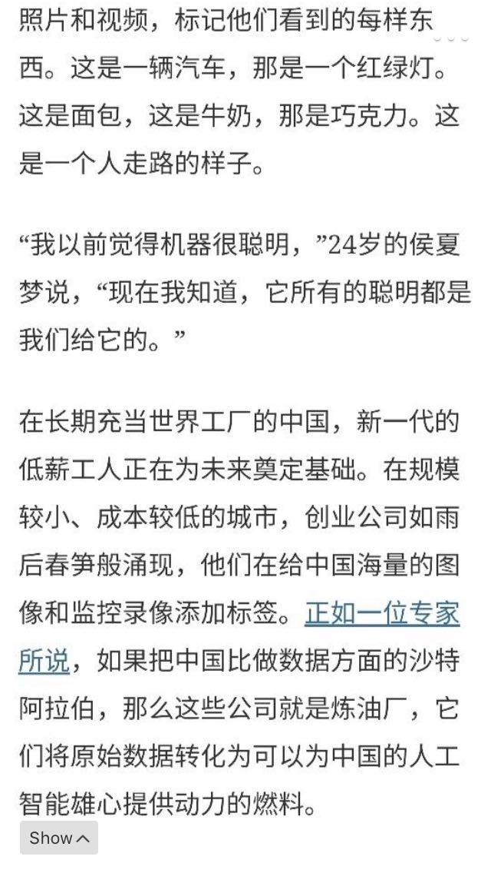
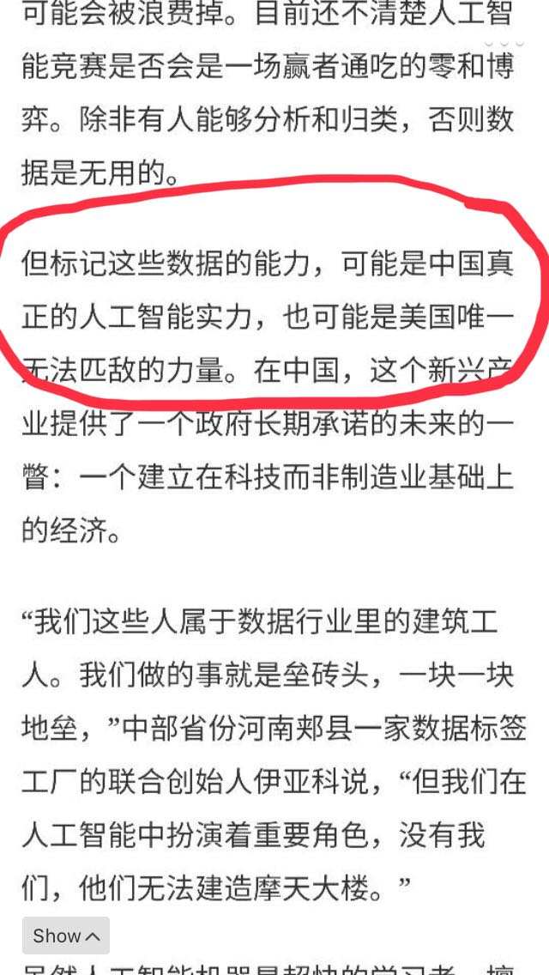
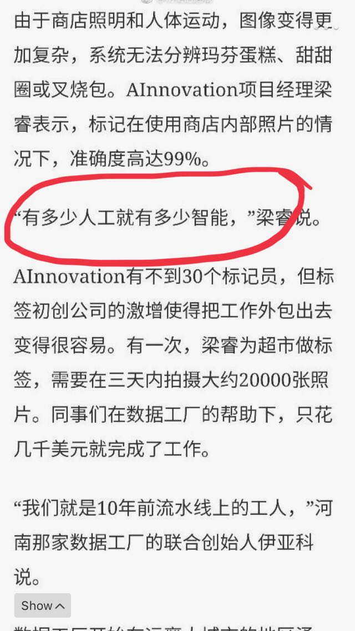
End-to-end: Pros and cons
Notes:
假设当前训练集只有2个样本，学习算法就可以很清楚的记住这两个模型的特征，有意义的没意义的都给记住了，然后准确率就达到了100%，相应的错误率就是0%；这对于验证集就不是什么好事，比如说刚刚的样本一个是黑猫，另一只是白狗，我们的算法是判断是猫还是狗，经过这两个样本的训练，模型很可能把颜色记住了，对于验证集里面的黑狗很有可能被识别成猫，白猫被识别成狗，这样准确率就会很低，错误率就很高。
1

Slide 8
Pipeline or End-to-end ?
For specified task, choose pipeline or end-to-end, should consider:
1. Data availability
[Task] autonomous car
End-to-end:Need a large dataset of (Image, Steering Direction) pairs.
It is very time-consuming and expensive.
Pipeline: There are numerous computer vision datasets with large
numbers of labeled cars and pedestrians, it’s easy to build a
car detector and a pedestrian detector with these data.
Really?
Notes:
假设当前训练集只有2个样本，学习算法就可以很清楚的记住这两个模型的特征，有意义的没意义的都给记住了，然后准确率就达到了100%，相应的错误率就是0%；这对于验证集就不是什么好事，比如说刚刚的样本一个是黑猫，另一只是白狗，我们的算法是判断是猫还是狗，经过这两个样本的训练，模型很可能把颜色记住了，对于验证集里面的黑狗很有可能被识别成猫，白猫被识别成狗，这样准确率就会很低，错误率就很高。
1

Slide 9
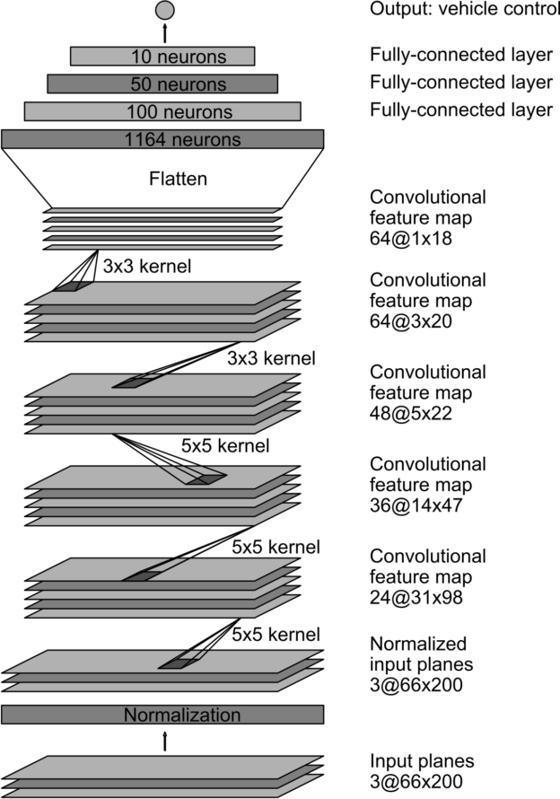
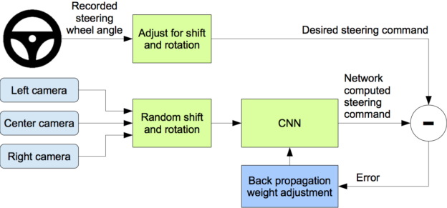
Pipeline or End-to-end ?
End to End Learning for Self-Driving Cars(By Nvidia)
Something interesting:
1. Training data was collected by driving about 72 hours on a wide variety of roads and in a diverse set of lighting and weather conditions.
2. The training data is therefore augmented with additional images that show the car in different shifts from the center of the lane and rotations from the direction of the road.
3. It’s able to learn the entire task of lane and road following without manual decomposition into road or lane marking detection, semantic abstraction, path planning, and control. A small amount of training data is needed.
It’s the success of end-to-end deep learning!
Notes:
假设当前训练集只有2个样本，学习算法就可以很清楚的记住这两个模型的特征，有意义的没意义的都给记住了，然后准确率就达到了100%，相应的错误率就是0%；这对于验证集就不是什么好事，比如说刚刚的样本一个是黑猫，另一只是白狗，我们的算法是判断是猫还是狗，经过这两个样本的训练，模型很可能把颜色记住了，对于验证集里面的黑狗很有可能被识别成猫，白猫被识别成狗，这样准确率就会很低，错误率就很高。
1

Slide 10
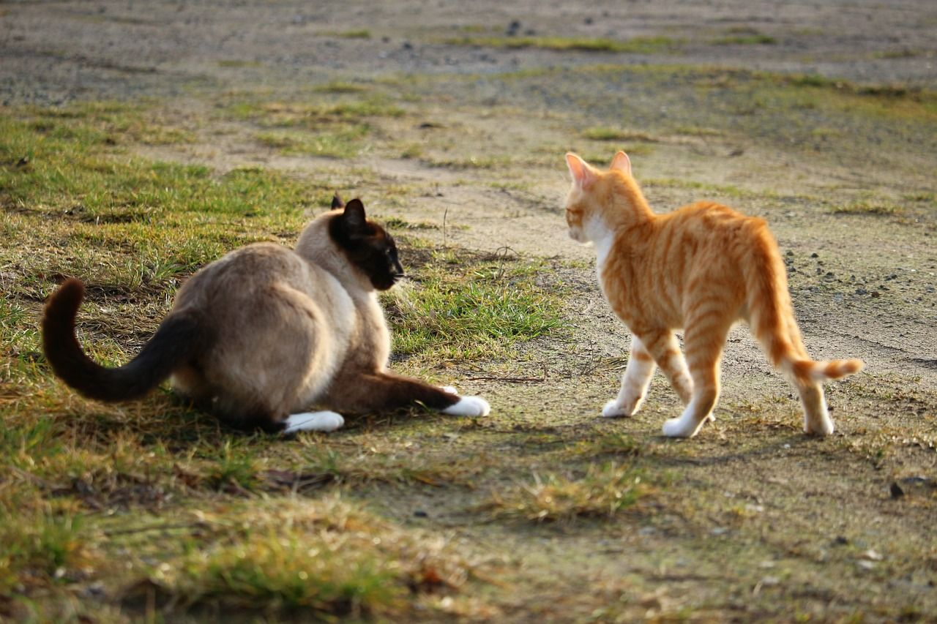

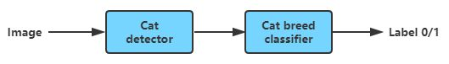
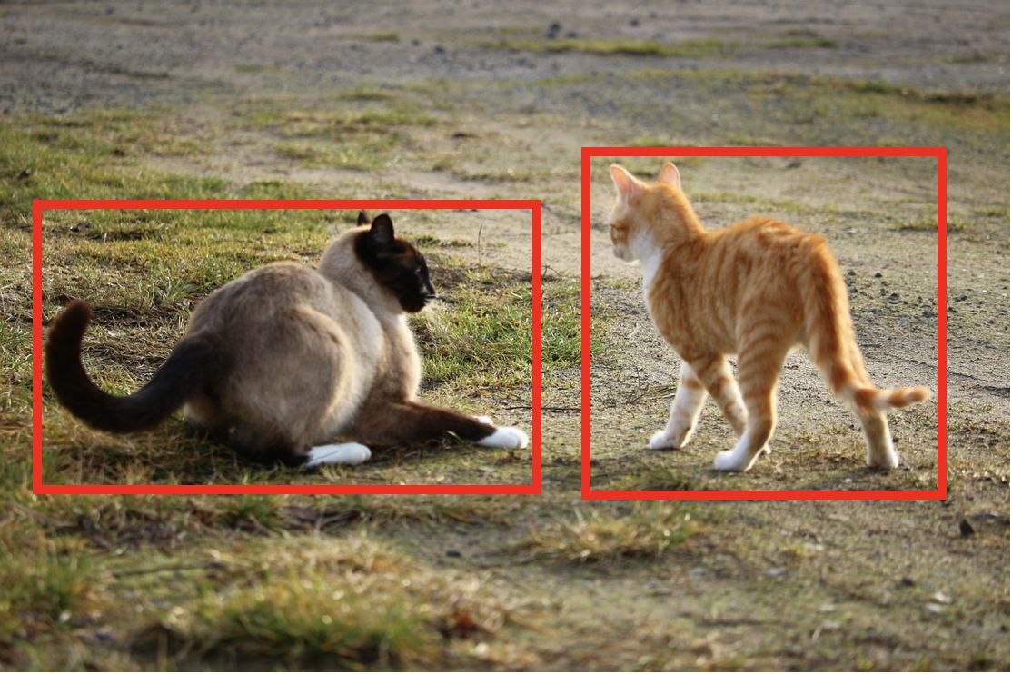
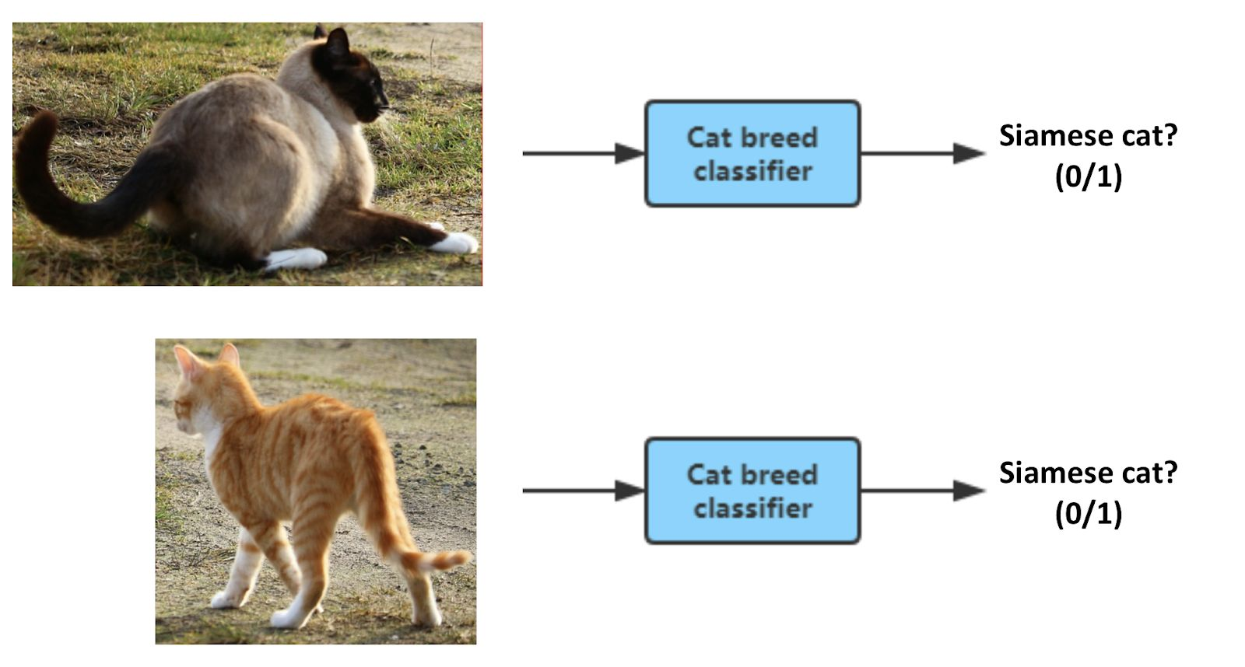
Pipeline or End-to-end ?
2. Task simplicity
[Task] Siamese cat detector.
End to end:
Pipeline:
Tips: how to define a task’s simplicity?
Notes:
假设当前训练集只有2个样本，学习算法就可以很清楚的记住这两个模型的特征，有意义的没意义的都给记住了，然后准确率就达到了100%，相应的错误率就是0%；这对于验证集就不是什么好事，比如说刚刚的样本一个是黑猫，另一只是白狗，我们的算法是判断是猫还是狗，经过这两个样本的训练，模型很可能把颜色记住了，对于验证集里面的黑狗很有可能被识别成猫，白猫被识别成狗，这样准确率就会很低，错误率就很高。
<number>

Slide 11
More
东北话和川普，机器都能听懂，吴恩达说的端到端学习究竟是什么？
End to End Learning for Self-Driving Cars.pdf
End-to-End Deep Learning for Self-Driving Cars
端到端的TTS深度学习模型tacotron(中文语音合成)
Notes:
假设当前训练集只有2个样本，学习算法就可以很清楚的记住这两个模型的特征，有意义的没意义的都给记住了，然后准确率就达到了100%，相应的错误率就是0%；这对于验证集就不是什么好事，比如说刚刚的样本一个是黑猫，另一只是白狗，我们的算法是判断是猫还是狗，经过这两个样本的训练，模型很可能把颜色记住了，对于验证集里面的黑狗很有可能被识别成猫，白猫被识别成狗，这样准确率就会很低，错误率就很高。
<number>

Slide 12
THANK YOU

